Slide 1
Regression and Attribution
Chilin Tang
Data & Analytics
Digitas Singapore

Slide 2
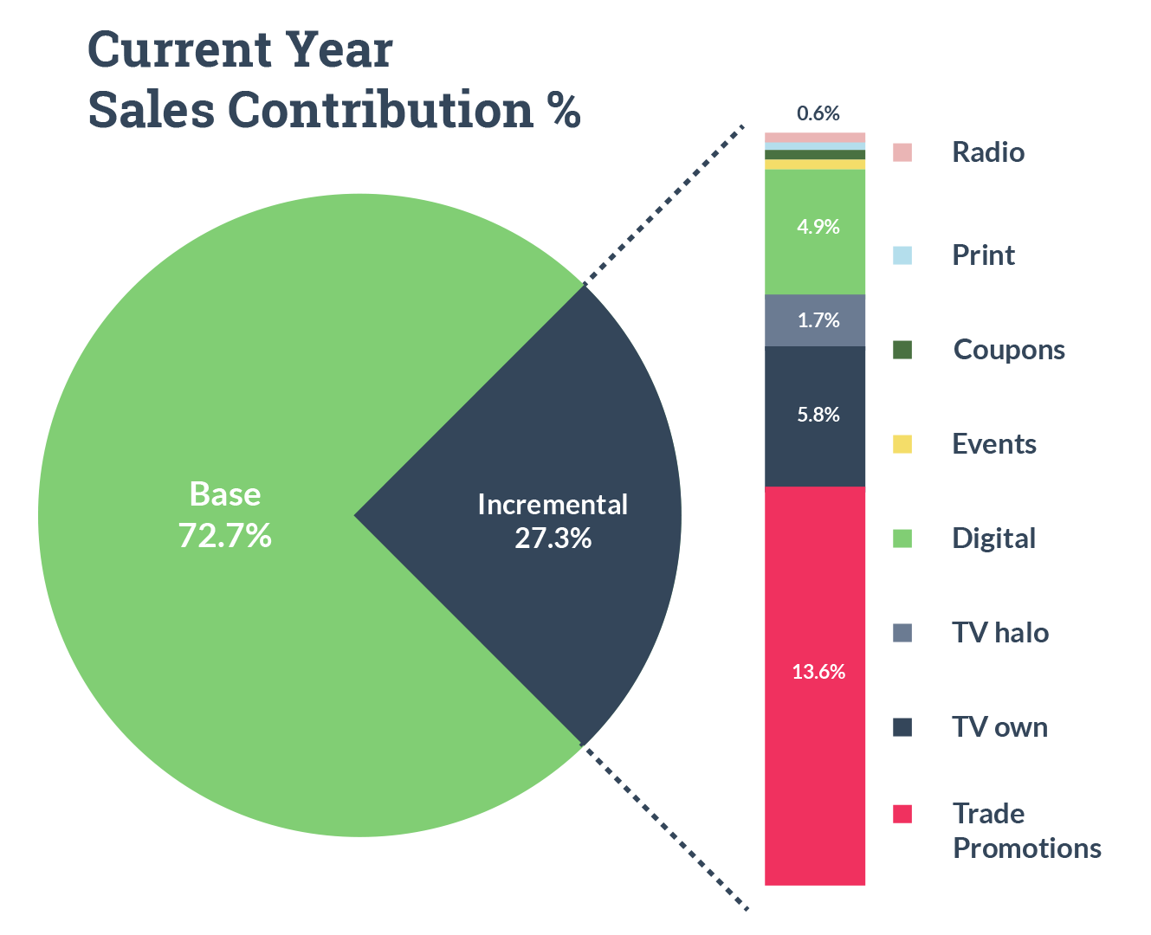
What is Marketing Mix Modeling?
Channel Impact for Sales
Modelling Time Period: Jul – Oct 2021
Modelling Time Period: Jul – Oct 2021

Slide 3
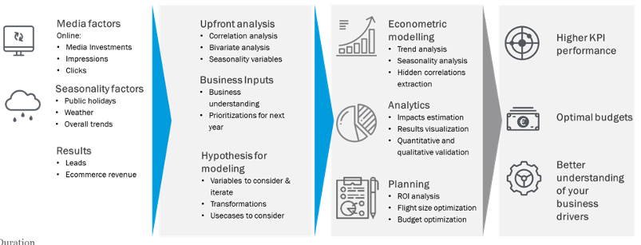
MMMs are made possible through Linear Regression Modelling
What does Linear Regression do?
Determines how much credit is given to each touch or data point leading towards a conversion (i.e. media spends / spreads on Sales)
Predicts conversion outcomes with fixed values for marketing inputs
Data Collection Exploratory Analysis Insights Outcomes

Slide 4



How does Linear Regression work?
What contributes towards an aircraft’s speed?
Pitch
Speed decreases
Speed increases
Bank
Speed constant
Engine Power

Slide 5
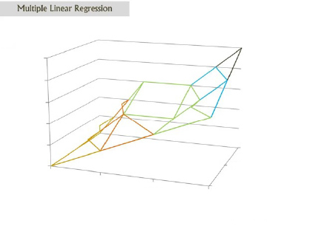
How does Linear Regression work?
Aircraft speed = pitch + bank + power
Speed
Bank
Power
Pitch

Slide 6
In the same manner, could Sales = Display + Video + Social?

Slide 7
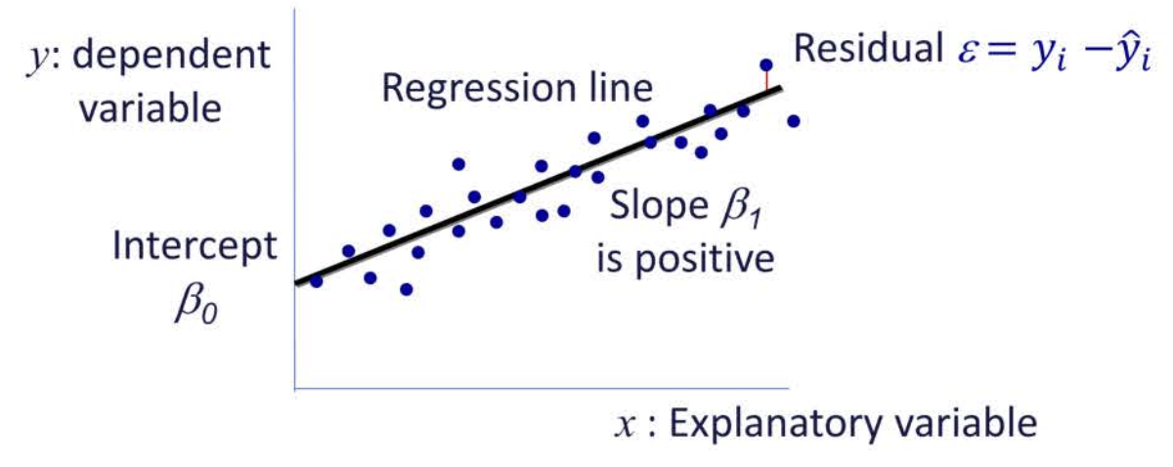
Remember this formula?
y = mx + c
where
m is gradient of slope
The sharper the gradient, the higher impact on y

Slide 8

ABBOTT ENSURE
Digital Rapid Read
Digital measurement for media performance and optimisation

Slide 9
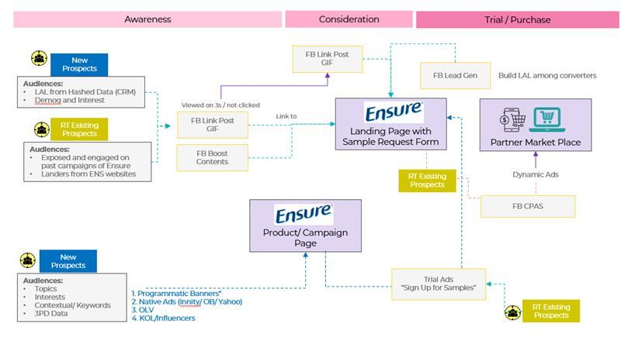
Abbott’s media framework for sales funnel

Slide 10

Distilling the impact of media channels
Impact of media
on ecommerce
INPUT VARIABLES
OUTPUT VARIABLES
Facebook
Programmatic
Direct partners
Native
eCommerce Sales
OLV

Slide 11



Abbott’s “Digital Rapid Read” model for scientific measurement of media performance
DATA
COLLECTION
EXPLORATORY DATA ANALYSIS
MODELING
USE IN
BUSINESS PLANNING
Media factors
Online:
Media Investments
Impressions
Clicks
Upfront analysis
Correlation analysis
Bivariate analysis
Seasonality variables
Econometric modelling
Trend analysis
Seasonality analysis
Hidden correlations extraction
Higher KPI performance
Business Inputs
Business understanding
Prioritizations for next year
Seasonality factors
Public holidays
Weather
Overall trends
Analytics
Impacts estimation
Results visualization
Quantitative and qualitative validation
Optimal budgets
Results
Leads
Ecommerce revenue
Hypothesis for modeling
Variables to consider & iterate
Transformations
Usecases to consider
Better understanding of your business drivers
Planning
ROI analysis
Flight size optimization
Budget optimization
Duration
Per model:
2 weeks
2 weeks
3 weeks
1 week

Slide 12
ABBOTT ENSURE
Digital Rapid Read
Digital measurement for media performance and optimisation

Slide 13
Once we have this attribution formula, we can optimise channel spends and predict sales
Sales = β₁ (Display) + β₂ (Video) + β₃ (Social)
Where value of β indicate significance:
β1 = How significant does Display channel improves sales
β2 = How significant does Video improve sales
β3 = How significant does Social improve sales

Slide 14
How do I know if Linear Regression (MMM) would work?
Data requirements can be stringent
Condition #1: Data inputs should not be related (correlated)
Outcome | Inputs
Weight | Calorie intake | Exercise
Sales | Youtube | CTV

Slide 15
How do I know if Linear Regression (MMM) would work?
Data requirements can be stringent
Condition #2: Inputs should point to the same outcomes
Outcome | Inputs
Sales (Product A) | Campaign 1 (product A + B) | Campaign 2 (product A)
Sales (Annual) | Campaign 3 (2 weeks) | Campaign 4 (3 days)

Slide 16
How do I know if Linear Regression (MMM) would work?
Data requirements can be stringent
Condition #3: Outcomes should have linear relationship with inputs
Outcome | Inputs
Sales (Product A) | Creative #1 run for entire year | Product A has not refreshed for 5 years

Slide 17
How do I know if Linear Regression model is accurate?
Due to predictive nature, errors are inherent in every analytics model.
Linear Regression formula is no exception, with ε expressing error value
y_{i} = β₁x_{i} + β₂x_{i+1} + β₃x_{i+2} + β_{i+3} + ε
3 key methods for analysing error in every Linear Regression model
Sum of Squares R²
Significance Testing (p value)
Mean Absolute Percentage Error (MAPE)

Slide 18
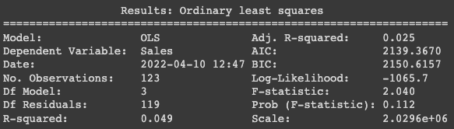
Sum of Squares R₂
The R2 (known as coefficient of determination) measures distance between predictive model and observed values from marketing data. Taking reference from mean of both sets, this is how R2 is calculated:
n
Σ (ŷi - ȳ)² sum of squares from regression (predictive) model
i=1
R2 =
n
Σ (yi - ȳ)² sum of squares from residual (observed) model
i=1
A higher R2 value represents a better model fit, due to variation or correlation between predictive and observed models. In the below example taken from Singapore use case, the R2 (denoted as “R. sq”) tell us which elements (or variables) of digital media budget account for 73% of variation for leads.
R-sqaured or R₂ values are typically displayed in Linear Regression engines

Slide 19
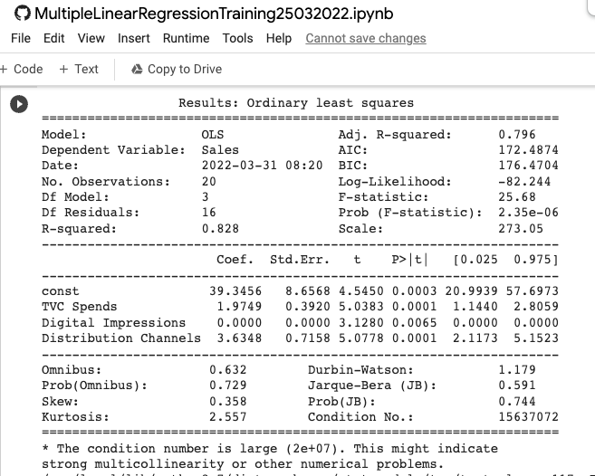
Significance Testing
From the Linear Regression formula, where β indicate significance of each input:
Sales = β₁ (Digital Media) + β₂ (Distribution) + β₃ (TV GRP)
Besides significance, the Linear Regression model would also provide errors (known as P value) for each input
Most Linear Regression engines (such as in Python) provide p values for each input or variable.
p values should be less than 0.1 (0.05 for single tailed) to be considered accurate

Slide 20
Mean Absolute Percentage Error (MAPE)
This is an alternative means of predicting accuracy of regression models. Expressed in % through the following formula:
100% n Actual observed value – Predicted value
MAPE = Σ
n t=1 Actual observed value
MAPE measures the difference between predicted and observed value. So a lower % value for MAPE (less than 5%) would indicate accuracy for predictive model.

